Slide 1
PERCEPTUAL HASH
(AN AMDAHL’S LAW EXPERIMENT)
By Jamar Mitchell and Elijah Balogun

Slide 2
HASHING
Function that takes in input and maps them to strings/numbers
The function is called the hash function
The mapped result is also known as the message digest.

Slide 3
PERCEPTUAL HASHING
Use of a Phash function to generate a message digest(fingerprint) of a multimedia file
Unlike the regular cryptographic hashing that generates drastic changes in output based on a small change in the input,Phash outputs are similar if the features of the inputs are also similar.

Slide 4
THIS PROJECT
Gets a list of images and calculates their perceptual hashes
Distorts the images by rotating them and using the phash function to recalculate their hashes
Task of hashing all the images in a list would be carried out by one worker thread(raspberry pi)and the execution time would be measured
The same task in then split across two worker threads and the new execution time is measured

Slide 5
TESTS
TEST 1
The original image is hash using the phash function
Rotates the original image by 1 degree(which is a minimal change) and the hash is recalculated.
The hash distance between the original image is then calculated and the distance is expected to be low because the image was slightly altered

Slide 6
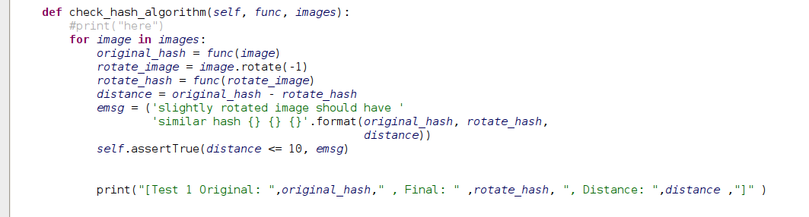
Test 1-Code
Ran in 43.327s

Slide 7
TESTS
TEST 2
Same as test 1 but the original image is rotated by 90 degrees and the phash is recalculated.
The hash distance is expected to give a much higher value as the original image has been altered a lot more than it was in test 1.

Slide 8
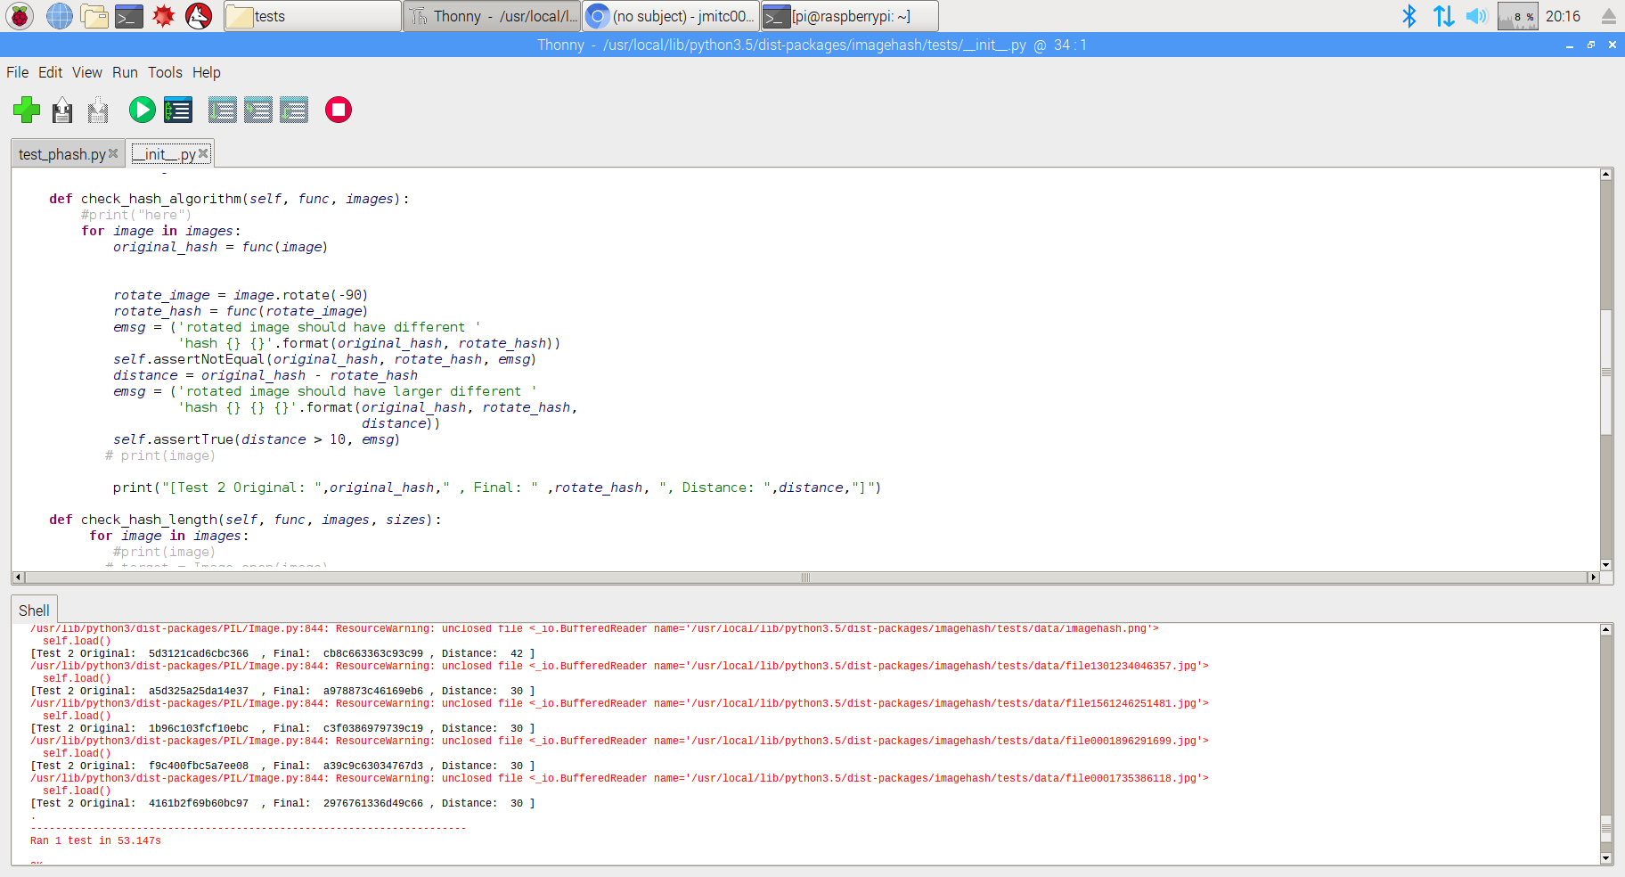
Test 2-Code
Ran in 51.451s

Slide 9
Verification of Amdahl’s law
To verify Amdahl’s law, the worker thread (raspberry pi) would be doubled to allow the execution run in parallel.
The execution time of the parallel processing is measured and used to calculate speed up as per Amdahl’s law

Slide 10
Amdahl’s law
Time to execute non parallel code= Tp
Time to execute code with parallel processors = Tp((1-f)+f/n) where f is the percentage done in parallel and n is the number of working threads
n in this experiment = 2, therefore
Speed up = Tp/Tp((1-f)+f/2)

Slide 11
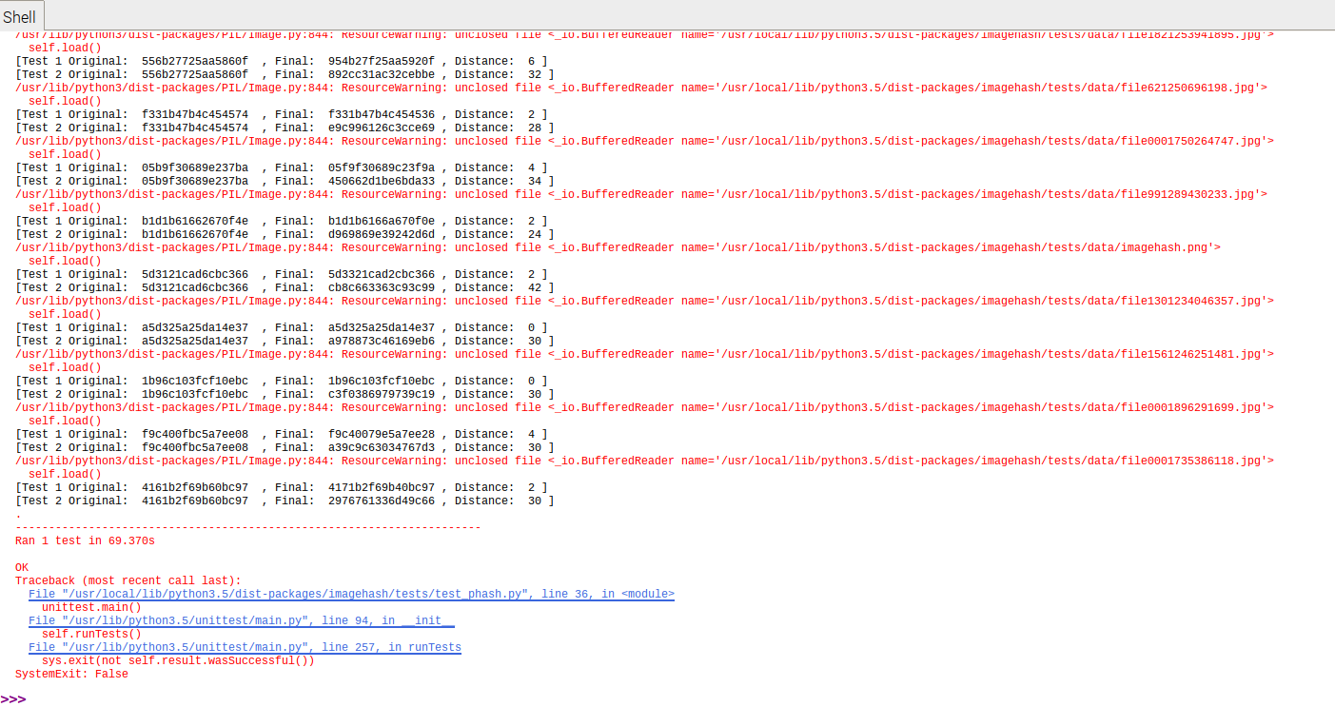
Test 1&2 on single RPi`

Slide 12
Test 1&2 in parallel RPi

Slide 13
Speed up
Experimental speedup = 69.370/53.147 = 1.301s (23.14%)
Theoretical speedup = Tp/Tp((1-f)+f/2)= 69.370/34.685=2(50%)

Slide 14
CONCLUSION
POSSIBLE REASONS
Sample size used was 30 images (small sample size)
Single pi | Two pis | Speed-up(experiment) | speed-up(calculated)
69.370 | 53.147 | 23.14% | 50%

Slide 15
THANK YOU

